Slide 1
Variations- Turing Machine
Lecture -12

Slide 2
TM Examples
Recognize the language {a^{i} b^{i} | i ≥ o}
Recognize the language {a^{i}b^{i}c^{i} | i ≥ o}
Recognize the language {a^{i}b^{i}c^{i}d^{i} | i ≥ o}
Reverse, copy, concatenate, erase and input string
Solve the Travelling Salesman Problem
Encrypt/decrypt using RSA
Check whether a number is prime
Add, multiply, divide, square etc…

Slide 3
Variations of Turing Machines
Multi-Track TM
Multi-Tape TM
2 Stack Machine
Non-deterministic TM
The variations appear to increase the capability of the machine !

Slide 4
Multi –Track TM
Multiple tracks but just one tape head reads and writes on all tracks.
Single tape head reads n symbols from n tracks at one step
δ(Q_{i}, [a₁, a₂, a₃,....]) = (Q_{j}, [a₁, a₂, a₃,....], Left_shift or Right_shift)

Slide 5
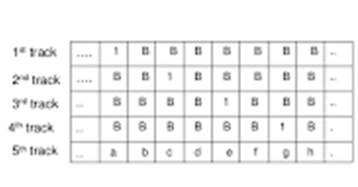
Multi –Track TM
Tape Header

Slide 6
Multi-Tape Turing Machines
A k-tape machine has
k-tapes and k independent tape heads
M reads the tape simultaneously but has only one state
Transitions
Change the state
Write a symbol on each tape
Independently reposition tape heads: left, right, stationary
Advantages
Ability to copy
data between
tapes
To compare strings
on different tapes

Slide 7
Multi-Tape TM
δ(Qi, [a1, a2, a3,....]) = (Qj, [a1, a2, a3,....], Move1,Move2,Move3)

Slide 8
2 Stack TM
First stack can hold what is to the left of the head, while the second stack holds what is to the right of the head,
Neglecting all the infinite blank symbols beyond the leftmost and rightmost of the head.

Slide 9
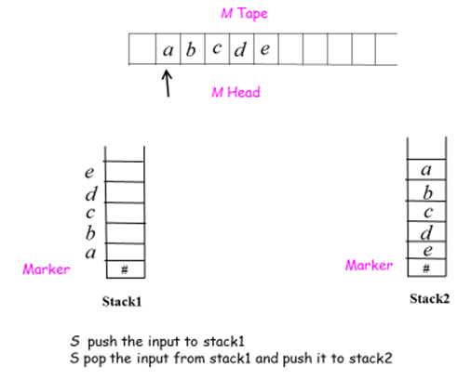
2 Stack TM

Slide 10
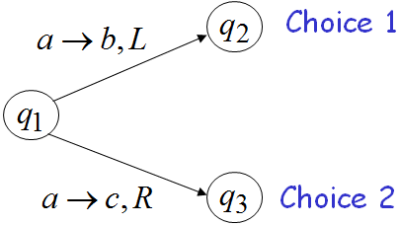
Non-deterministic TM
NTM allows a finite number of transitions to be specified for a given configuration (current state and tape symbol)
meaning more than one action for a given configuration
δ(q_{i}, x) = {(q_{j}, y, d), (q_{k}, z, e), …}

Slide 11
Non Deterministic Turing machine
Time 1
Choice 1
Choice 2

Slide 12
NTM contd…
Acceptance in NTM can be final state or halting
NTM may produce multiple computations for a single input string
Whereas a DTM has a single "computation path" that it follows, an NTM has a "computation tree". If at least one branch of the tree halts with an "accept" condition, we say that the NTM accepts the input.
Nondeterministic Turing machines are equivalent with deterministic Turing machines.

Slide 13
Conclusion
TM has variations
Each new machine has the same power as standard Turing Machine (accept the same set of languages)
Non-determinism does not increase the capabilities of TM
Languages accepted by NTM are precisely those accepted by deterministic machines

